Slide 1




PetExec Review
Amirhossein Sabagh
December 03, 2020
Individual Presentation
Notes:
Hello, this is Amir from group 6 of course SYD366; I hope, in this snowy evening of Toronto, you are doing fine and keeping safe.
I am here today to analyze the dog grooming software PetExec and find out why do I think it is a good fit for Christy’s grooming business.

Slide 2

List of Content
Overview
Customer Management
Inventory Management
Scheduling
Price
Open-Source

Slide 3

Overview
PetExec is a state-of-the-art, cloud-based system to manage pet daycare, boarding, grooming, training, retail & other services.
PetExec sends automatic emails or texts for appointment reminders, pet birthday, and vaccination due alerts.
Your pet parent can log-in securely schedule appointments real time, check pet records, and purchase history.
PetExec Mobile App for pet parents increases efficiency and communication. Excellent support & coaching! Compatible with any device.
Notes:
PetExec is a cloud-based solution for pet care businesses that helps them run more efficiently and encompasses daycare, boarding, training, grooming and more. For Christy, this software not only meets all the needs her grooming business has, but also provides the context if she ever wanted to expand her business and cover more areas like daycare and training dogs.
PetExec helps keep track of pets through detailed information, including photo thumbnails. The cloud-based system is accessible from anywhere and works well for small-medium businesses. Its scheduling, appointment, reporting and other tools allow businesses to streamline their operations using the drag-and-drop calendar and an intuitive interface.
PetExec is a modern and feature-rich platform for pet care businesses that is accessible from anywhere and allows concurrent users at the same time. The system automatically backs up data, while AES-256 bit encryption ensures data integrity and security. Not only the platform offers advanced features, but it’s also easy to learn and allows users to start right away. Personalized trainings and web sessions allow coaches to work directly through the system and make recommendations as the session progresses. Users can invite anyone to these sessions and teach individuals as well as small groups.
The system makes it easier to manage most of the common business functions more efficiently and makes employee scheduling painless. Different administration levels means users only have access to the permitted information. The combined dashboard provides a brief overview of current status and allows filtering and sorting information. The reporting tools allow quickly generating reports for different activities such as financial transactions, history, calendars and more. Data can be exported to QuickBooks, while the system also allows giving access to accountants who can collect financial data and business reports anytime, from anywhere.
Build-in email functionality offers branded and customizable emails that make it easier to manage appointments, vaccination and other pet services. The system automatically sends confirmation and reminder emails, while they can also be easily tracked and used to communicate any changes. The PetExec API allows extracting information from a date range and provides data developers can use for displaying in calendars.

Slide 4

Customer Management
Let’s dive in

Slide 5
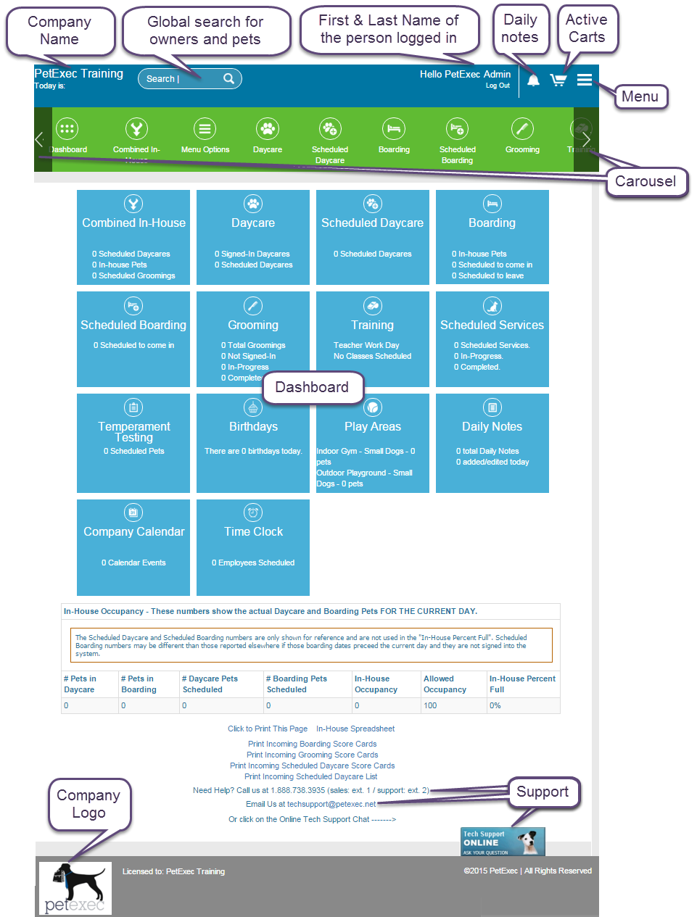
Main Dashboard
Notes:
PetExec has made client communications so much more streamlined, it automatically sends out
birthday cards or appointment reminders to clients. clients can make their appointments online
It allows Christy to focus on the part of the business that she enjoys which is the human
aspect connecting with the owners and working with the dogs

Slide 6
How PetExec is able to classify customers according to the client’s requirements?
Schedule a grooming service by itself or add grooming to a boarding stay in just a few clicks
Track groomer commissions and tips; print detailed reports
View a monthly, weekly, or daily calendar of upcoming groomer appointments
Manage multiple groomers with ease with color-coded views to quickly see groomer availability
Create custom grooming services and set your prices according to your own desired specifications.
Set different pricing types by breed and/or size to determine correct pricing.
Give groomers the ability to set their own unique pricing and schedules.
Notes:
one of the things that I think Christy needs is to send daily
report cards which pet exec makes
extremely easy. She can do it straight from
the dashboard, she can immediately email
the report cards, or she can also text the owners,
basically communicate with them the way
they'd like to be contacted

Slide 7
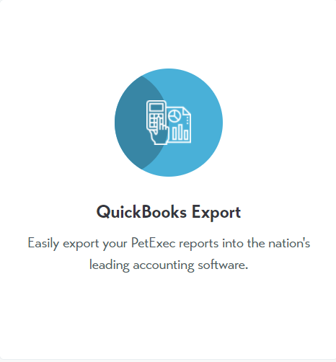
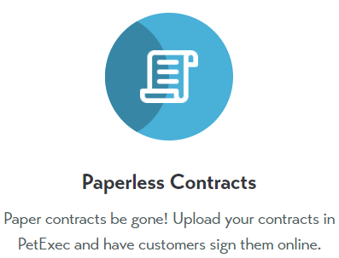
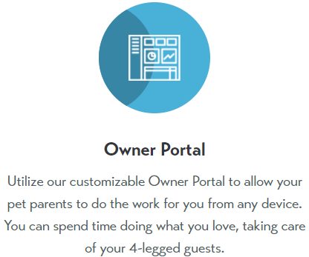
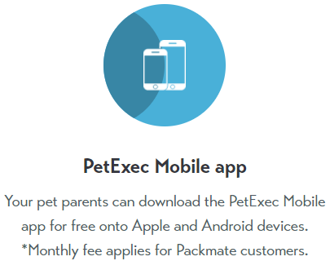
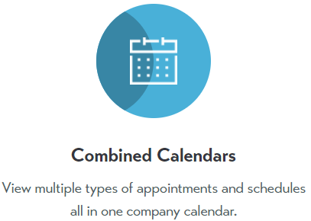
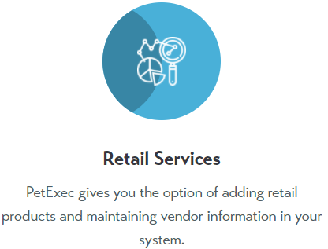
Notes:
Due to lack of time, I will just display a bunch of other features PetExec software has that I believe could help Christy’s business to ease the client management for her

Slide 8
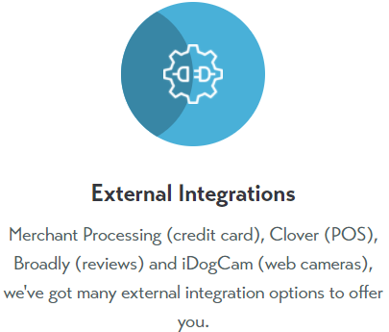
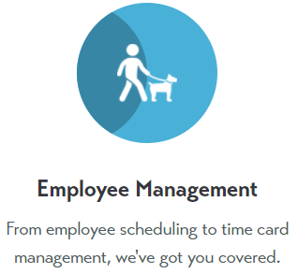
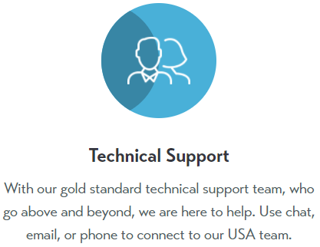
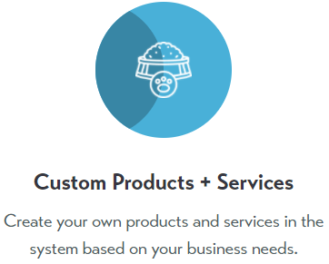
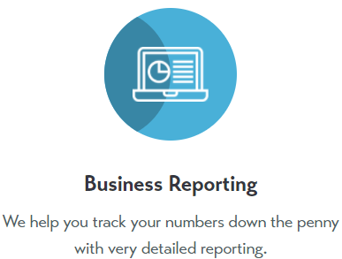
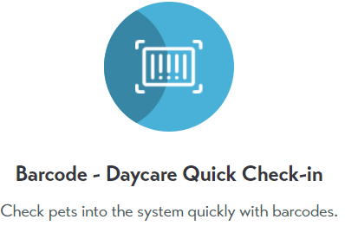

Slide 9
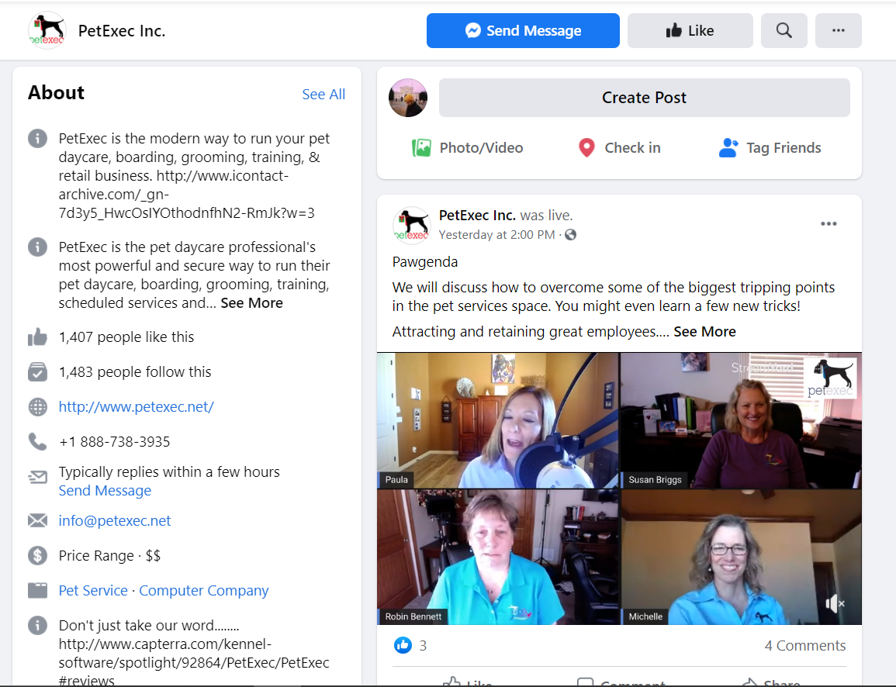

PetExec’s
Facebook
Community
Notes:
PetExec has one of the best customer and technical support
Christy will be able to call them, email them, chat with them directly from the dashboard where they know who she is
immediately they can see her screen and help her with any questions she might have. And additionally, they have a
Facebook page with over 700 people that used PetExec all over the world and it's just a great community and Christy can learn a lot from that group as well

Slide 10
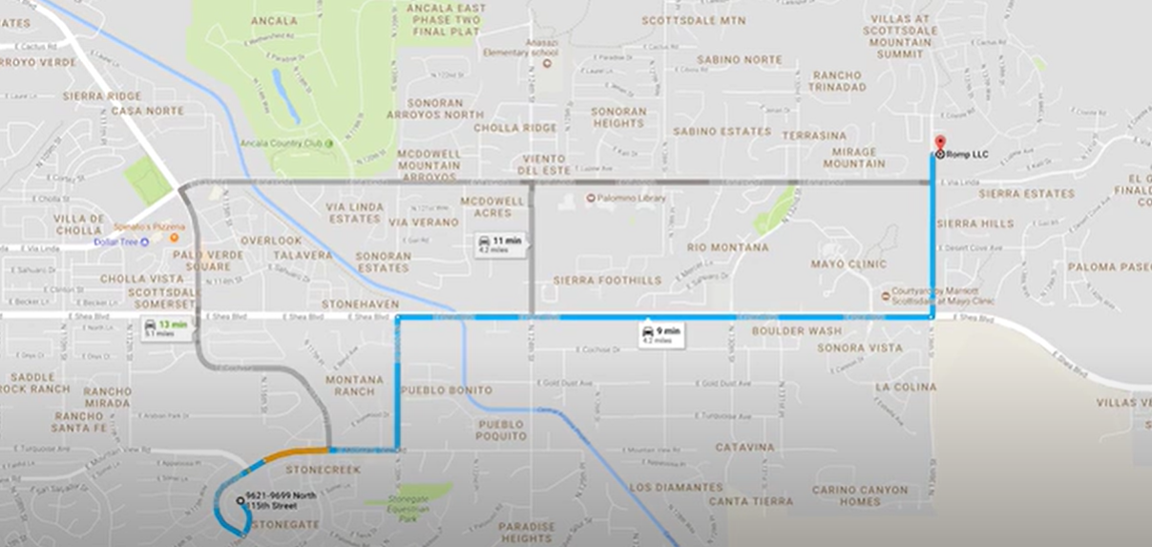
Notes:
She is also able to map directions to owners homes directly from petExec at the dashboard, so if she has to run a dog home it's very easy, it keeps her very connected with her customers which is ultimately what they want.

Slide 11

Inventory Management

Slide 12
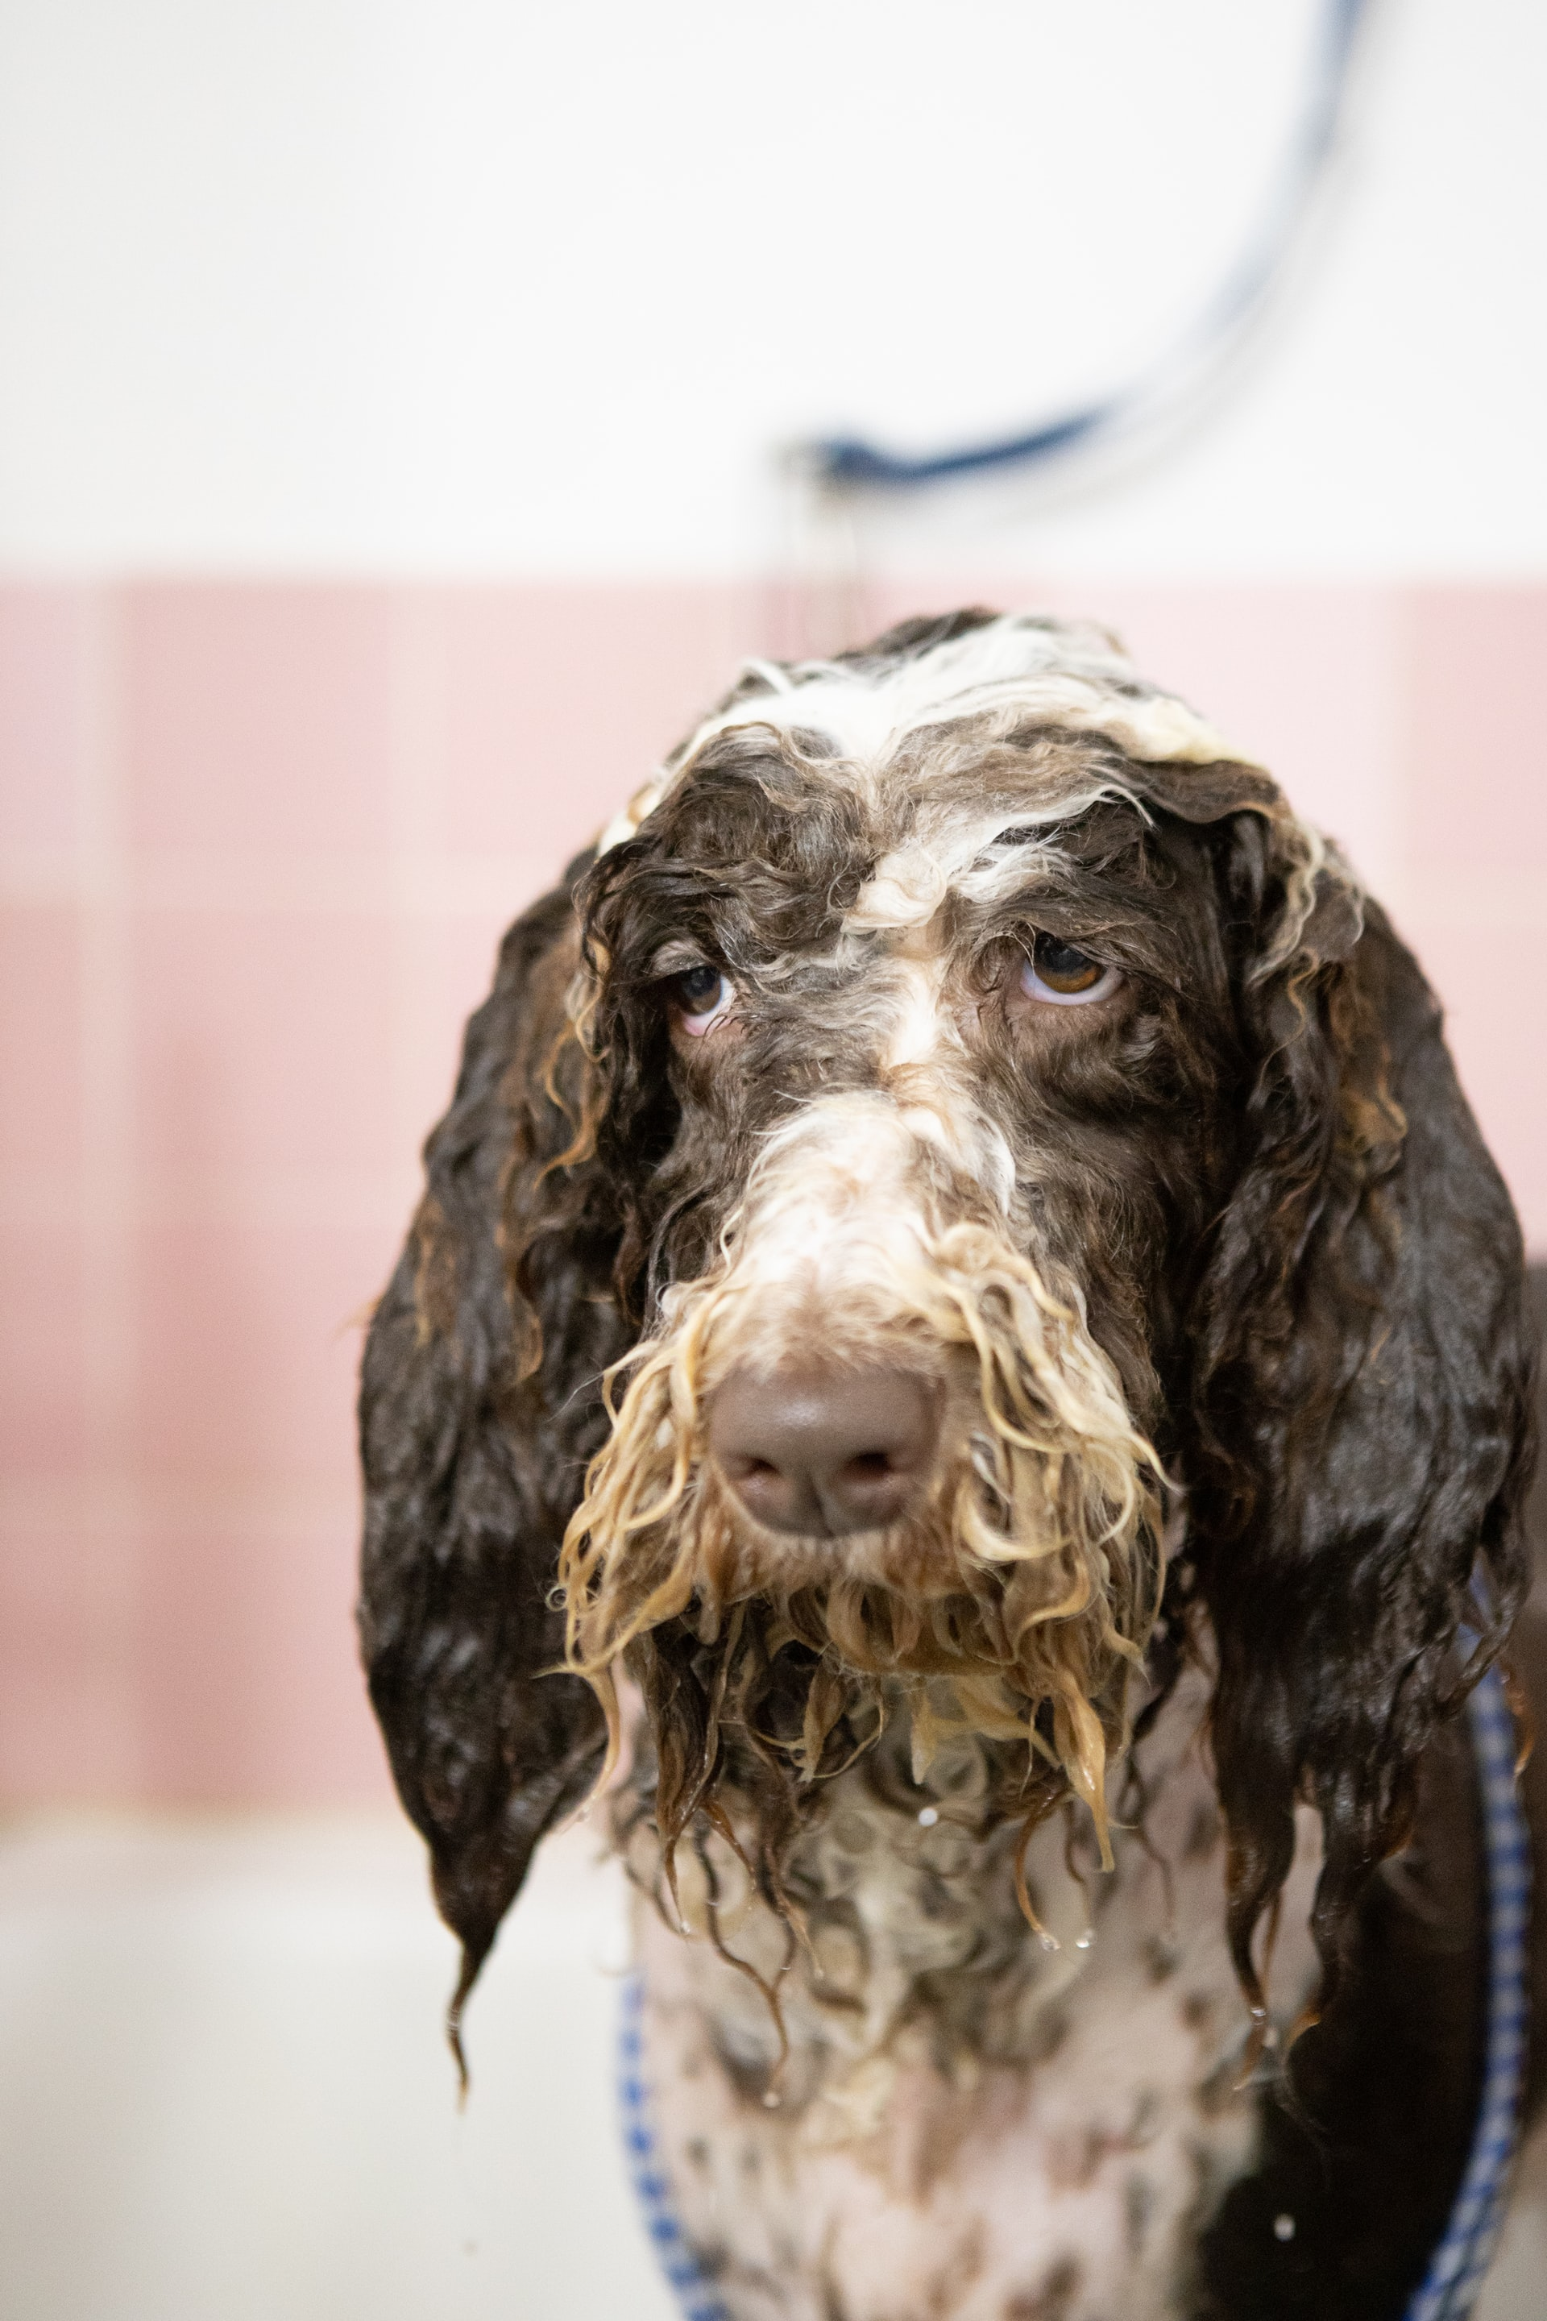
PetExec claims that
“Our reports are an accountant's dream!”
Keep track of revenues, take a look at projections and comparisons, and view statistics on a daily basis all with our detailed accounting reports.
From accounting to employee, grooming, inventory (retail), vets, and owner/pet reports, we have it all.
Notes:
PetExec can help Christy out in the business side tremendously knowing how to run reports and get all the
financial information that Christy needs to be able to run a dog business are made extremely easy by PetExec

Slide 13
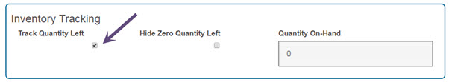
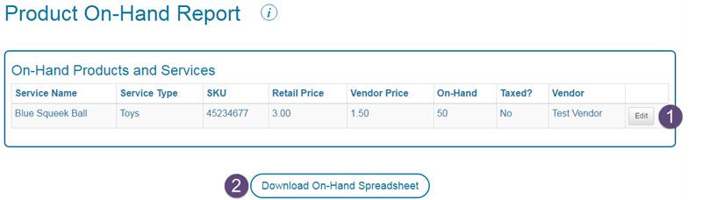
Inventory tracking
Notes:
The Product On-Hand Report shows all of the products that are identified for inventory tracking. The report provides a list of all products being tracked and provides a quick link to update the product's relevant information. The report can be downloaded to an Excel spreadsheet.
The spreadsheet contains the following columns: Product Name, Service Type, SKU, Retail Price, Vendor Price, Holiday Price, Quantity On-Hand, Vendor(s), Notes, Vendor Notes

Slide 14
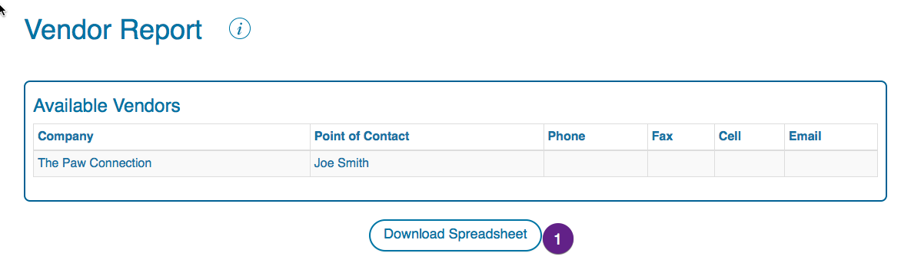
Notes:
Vendor Report
The Vendor Report provides a list of the vendors you have entered into your system. It can be downloaded to Excel.

Slide 15
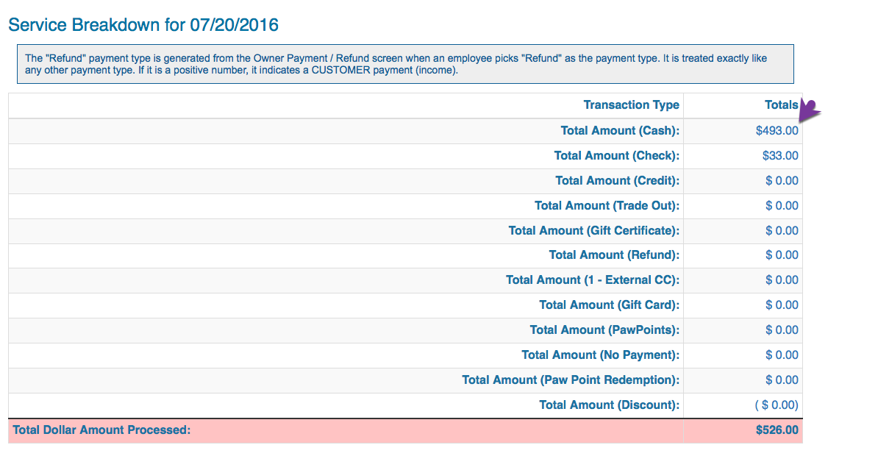
Daily Statistics Report
Notes:
The Daily Statistics Report is a report of the daily transactions by payment type. Items are broken down for you so you can easily see what transactions were made for a specific day.

Slide 16
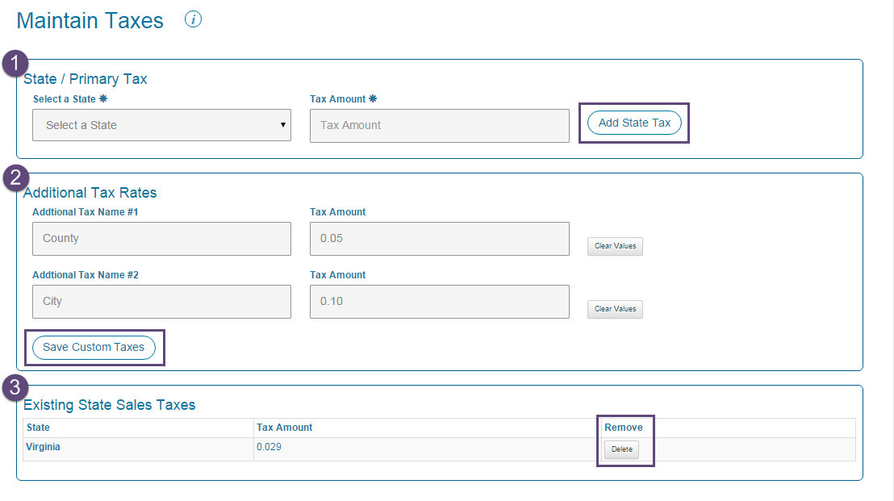
Maintain Taxes

Slide 17
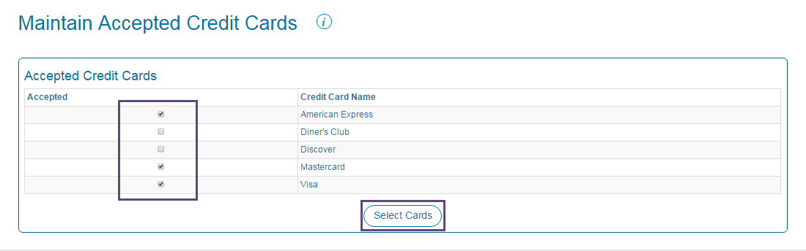
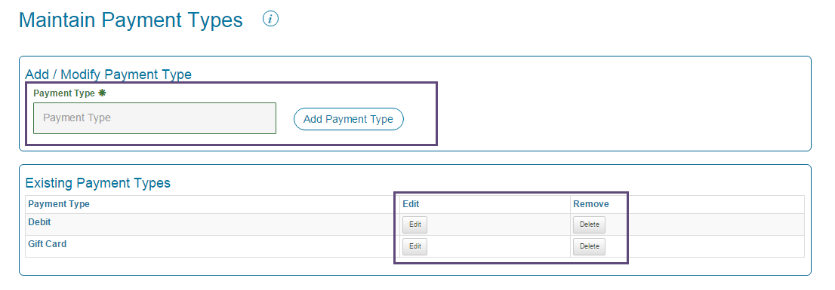
Notes:
Christy can also add and maintain payment types with PetExec. Some of the default payment types that she can choose from are
Cash
Check
Credit Card
Tradeout
Refund
Gift Certificate

Slide 18
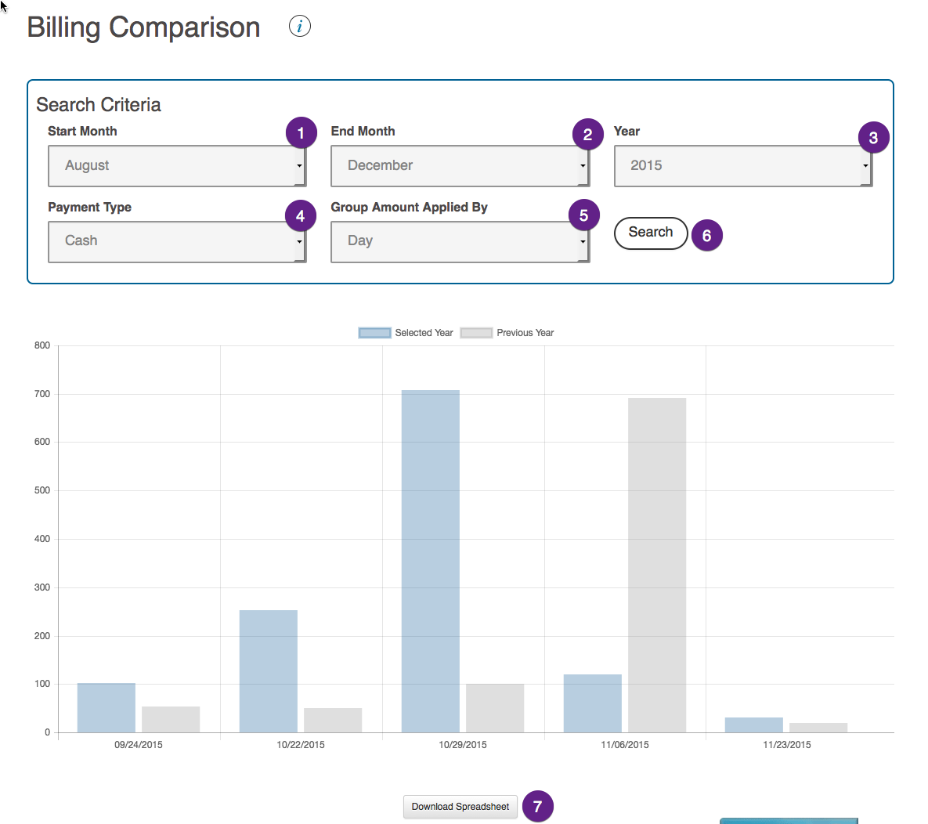
Notes:
The Billing Comparison Report is a chart of the selected year and previous year's data for the same timeframe by payment type.

Slide 19
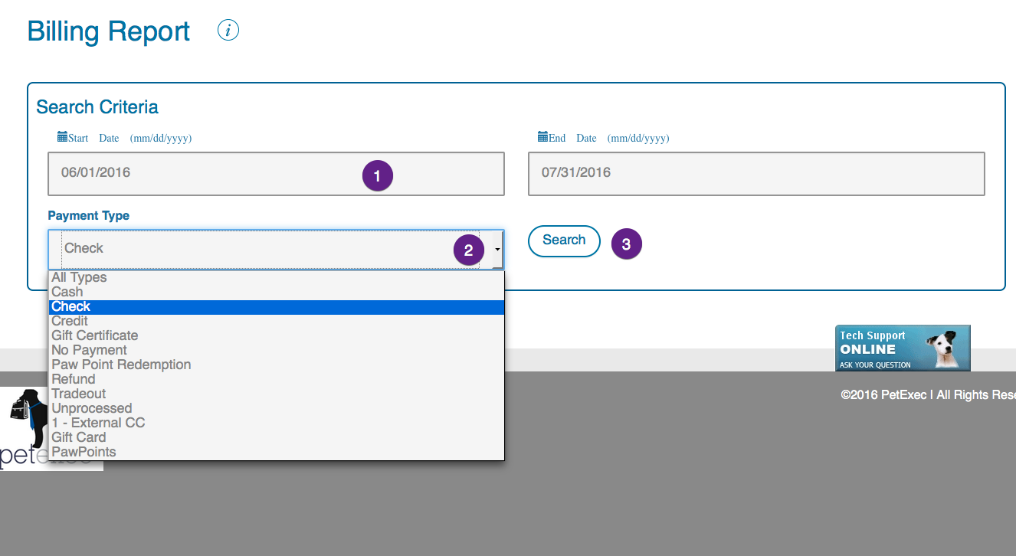
Notes:
The Billing Report is a spreadsheet customized by date range and payment type that can be sorted by Order ID, Original Order Date, Process Date, Charge, Payment Type, Tax or Owner (and other options).

Slide 20
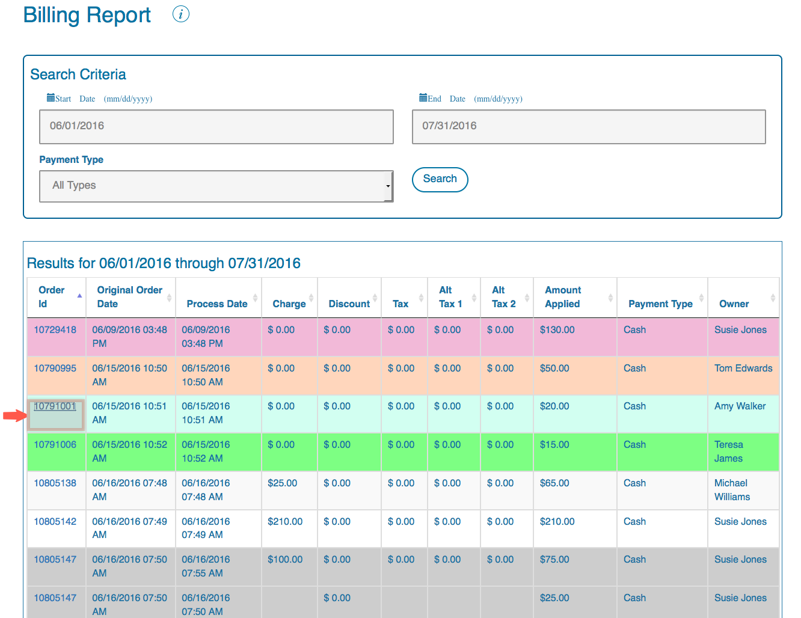
Notes:
The results are color coded to indicate whether the record is a Payment order (pink), a Pre-Payment order (orange), a Credit to Owner (blue) or a Balance Adjustment (green). Multiple payment histories against the order are in gray.

Slide 21
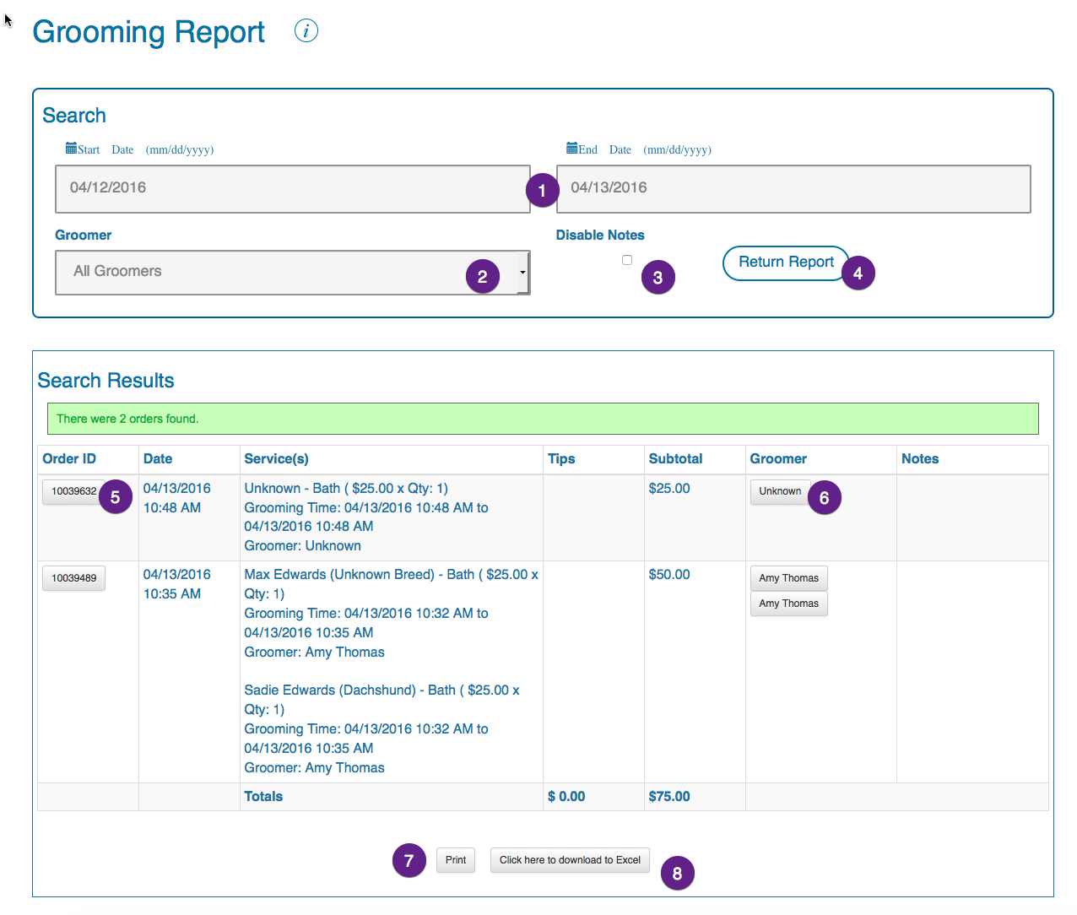
Notes:
The Grooming Report returns a list of completed grooming orders for the selected date range. You can specify one groomer or all groomers to view.

Slide 22

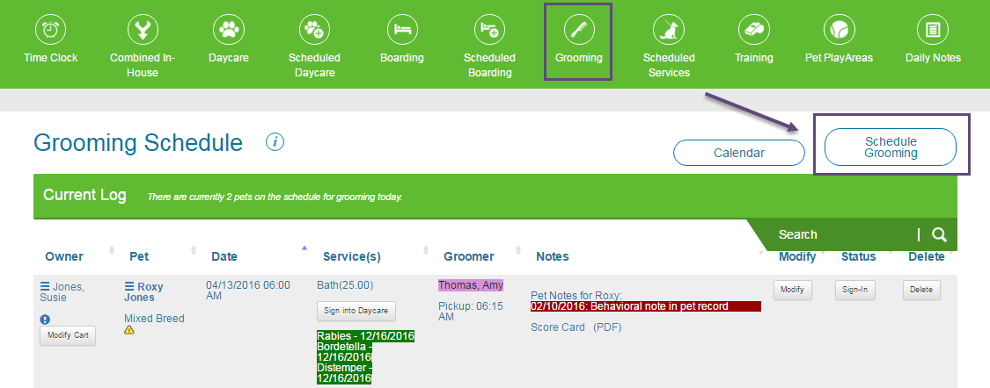
Scheduling
Notes:
Groomers have a tough job! Managing schedules, reminding customers about appointments and other tasks get in the way of actually doing the grooming. Not anymore! PetExec automatically sends confirmations and reminders, groomers can manage requests with a few clicks and drag-and-drop groom appointments from groomer to groomer on the schedule. Text customers from the dashboard to let them know their pet is ready and with Pet Snaps Messaging or take a quick snapshot of their adorable furry pet child and send to the parent.

Slide 23
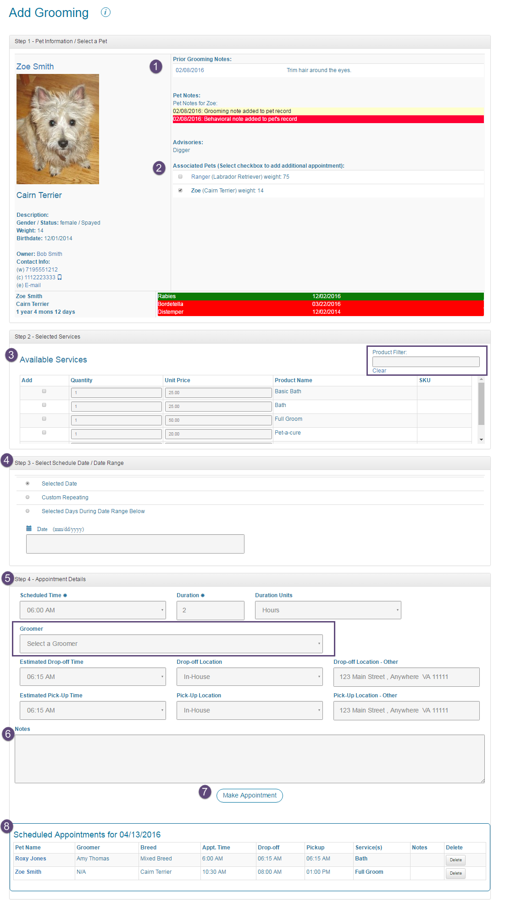
Notes:
Here I provided a screen shot of the process of adding a grooming schedule, showing how extensive and full the form and the whole PetExec platform is

Slide 24
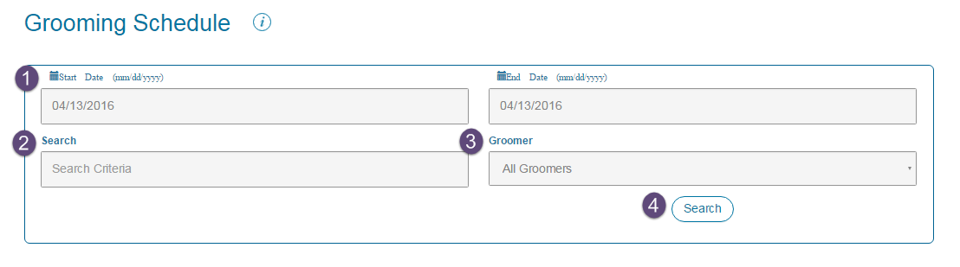
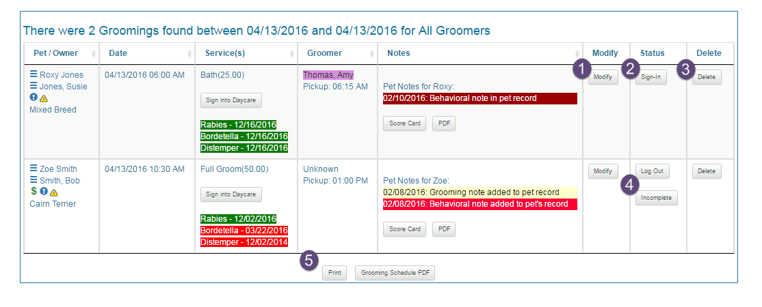

Slide 25
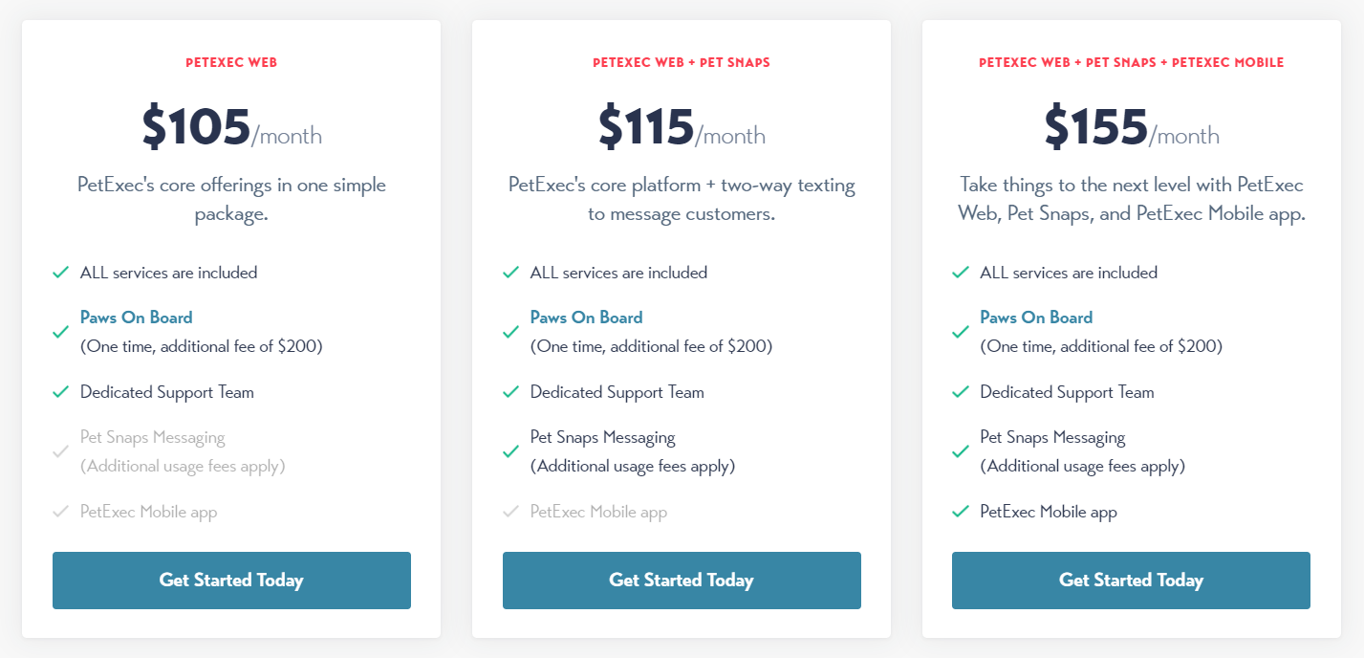
PRICE
Notes:
PetExec pricing starts at $105.00 per month. They do not have a free version but they offer a free trial
They also have 100% Money Back Guarantee on initial monthly subscription charge.

Slide 26

PRICE
Intuitive with many customizable preferences
No limit on simultaneous users
Invitation to the PetExec closed Facebook page exclusively for PetExec packmates
Amazing customer support via online chat, email and phone
Secure back-up of data continuously with cloud-based hosting
All of the features
Unlimited simultaneous users
Data transfers cost extra $300 (non-refundable)
Barcode Tags cost $265 (quantity: 500)
All PetExec system upgrades
256 bit High-grade encryption for data security
Notes:
Comparing to its competitors and respecting the key notes I am presenting to you now like Unlimited simultaneous users and amazing customer support, PetExec offers one of the best deals in the market.
PetExec brings the best to the table, plain-and-simple. Business owners can take a peek at the shared demo and/or let the PetExec take them on a tour of PetExec in an online experience.
By offering various plans and separating extra features like barcode tags from the plans, they want businesses to feel very comfortable with the variety of options and flexibility offered by PetExec.

Slide 27
Devices Supported
iPhone /
iPad
Windows
Mac
Web-based
Linux
Android
Cloud
SAAS
Notes:
PetExec has a responsive design. It works great with any device, your smartphone, tablet, PC or Mac, they all work great with PetExec

Slide 28
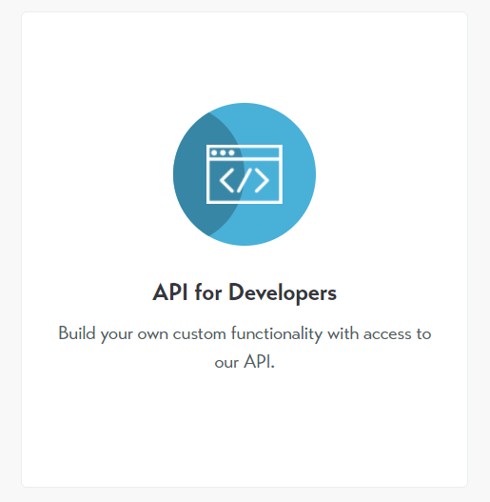
Open-Source
PetExec is built for everyone and is incredibly flexible when it comes to managing your robust pet care business.
Set up PetExec's Application Programming Interface
Notes:
For those looking to expand on the functionality that PetExec offers, they offer a robust and fully capable API with documentation for those software developers who want to take things to the next level.

Slide 29






Summary
Able to classify customers according to the client’s requirements?
YES
Record Income?
Record Expenses?
YES
Able to record price lists as per the client’s requirements?
YES
Record Purchases?
Record Sales?
YES
Classify Inventory?
YES
Allow for Scheduling?
YES

Slide 30


Summary
Is the software affordable?
YES
Is the software available through Open Source?
YES
What operating system will this run under?
Windows – Mac – Linux – Web-based – iPhone / iPad – Android

Slide 31

Conclusion
Thanks for reading my review of the PetExec grooming software.
This presentation report is prepared for the Individual Presentation project of course SYD366 at Seneca College.
Amirhossein Sabagh
asabagh@myseneca.ca

Slide 32
References
https://unsplash.com/photos/V2NXVXC5sb4
https://unsplash.com/photos/qwIeh5M8bF8
https://unsplash.com/photos/dHIRbh9En6I
https://unsplash.com/photos/k8xJOnA3zYM
https://unsplash.com/photos/usjV6EmMeEM
https://unsplash.com/photos/kEaYA1TdF34

